Slide 1
Preprocessing of video streams for extracting queryable representation of its contents using OpenCV
Ashutosh Upadhye UTA ID: 1001581542
Aditya Karve UTA ID: 1001550601
University of Texas at Arlington
Email: ashutosh.upadhye@mavs.uta.edu
Email: aditya.karve@mavs.uta.edu
This is a 10 + 3 min presentation of the project details

Slide 2
References, if any
Any papers, material (from internet or otherwise) you are using for this project
How to Extract and Model Useful Information from Videos for Supporting Continuous Queries
By Manish Kumar Annappa
2. answers.opencv.org
We used this forum to find solution for tackling issues related to finding contours in an image.
3. docs.opencv.org
For official documentation
4. A Viable Stream Processing Approach For Video Analysis
by Dr. Sharma Chakravarthy, Mr. Alex Aved and Mr. Mayur Arora

Slide 3
Acknowledgments, if any
We would like to thank Prof. Dr. Sharma Chakravarthy and Mr. Abhishek Santra for their constant help, support and guidance
We would like to thank Mr. Mayur Arora for his help and inputs.
We would also like to thank Mr. Manish Kumar Annappa, whose thesis paper helped us to understand the existing system greatly

Slide 4
Presentation should address (use as many slides as needed)
Brief description of the problem
Automating video stream processing for inferring situations of interest from video contents has been an ongoing challenge. This problem is currently exacerbated by the sheer volume of surveillance/monitoring videos generated.
Earlier work in this area use a custom query language to extract data and infer simple situations from the video streams, this adds to the workload by having to learn the query language

Slide 5
Description continued
So this project focusses on develop a framework in Opencv for pre-processing videos to extract the needed information from each frame. The information can be objects, their features (location, bounding box, and feature vectors), and their identification across frames.

Slide 6
Approach taken
Details of your Approach
The approach taken is to port an existing video preprocessing framework from MATLAB to Java, using OpenCV.
The existing video framework consists of detecting individual objects in a given video frame and extracting their features using feature detection algorithms (HIST/SIFT)
As OpenCV is fully open source, the framework could easily be ported to other platforms using C++ or Java.

Slide 7
Why is this approach better?
OpenCV 2.4.9 has APIs for SIFT/SURF and other feature vector detection algorithms which are open source, whereas in MATLAB the APIs are not open source.
As OpenCV is prone to development, it may get improved APIs which could be used in the future for the development of MavVStream.
So in summation, the broad objective is:
To port the existing functionality from MATLAB to OpenCV, using Java
To extend the current output representation

Slide 8
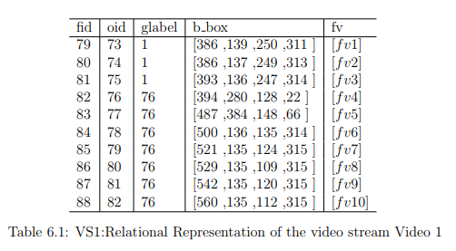
Details of theoretical results (use as many slides as needed)
The theoretical results are the output results from the matlab framework and we expect the same output from the opencv system:

Slide 9
Details of experimental results (use as many slides as needed)
Data sets used
We are using videos provided in the existing matlab implementation of the preprocessing framework. (atrium and it-lab videos)
These videos were chosen to test the performance of different feature detection algorithms in different scenarios.
Expected outcome
To obtain feature vectors from the objects of interest found in the video frames.
We hope to get a better understanding of OpenCV and video stream processing, which is a new topics for us.

Slide 10
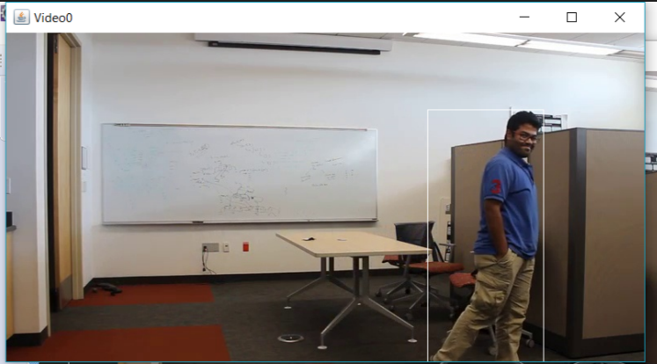
Results and importance

Slide 11
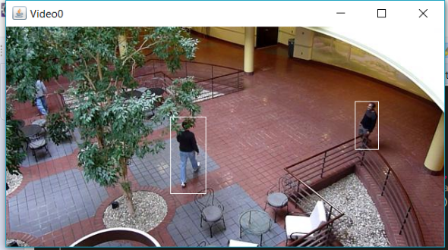

Slide 12
Details
Have you finished the project?
Yes we have finished and we have finished our milestones that are: Bounding Box Generation and background subtraction, Generating Hist and Sift Descriptors and implementing heuristics for frame comparison. The output for heuristics 1 and 2 is shown on next slides.
Did you encounter any problems
Currently Opencv 2.4.9 has memory leak issues for image matrices.
Moreover default sift descriptor is not a 128x1 vector. There is a huge workaround available for it.
Codebase for pre existing system in matlab is small but it is not the same case with the system ported in open-cv java.

Slide 13
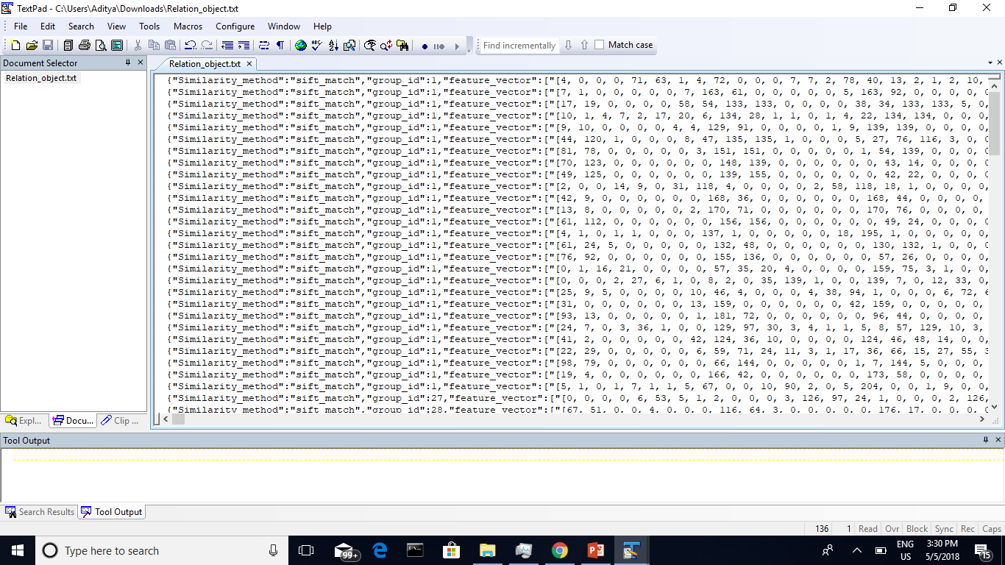
Object representation output

Slide 14
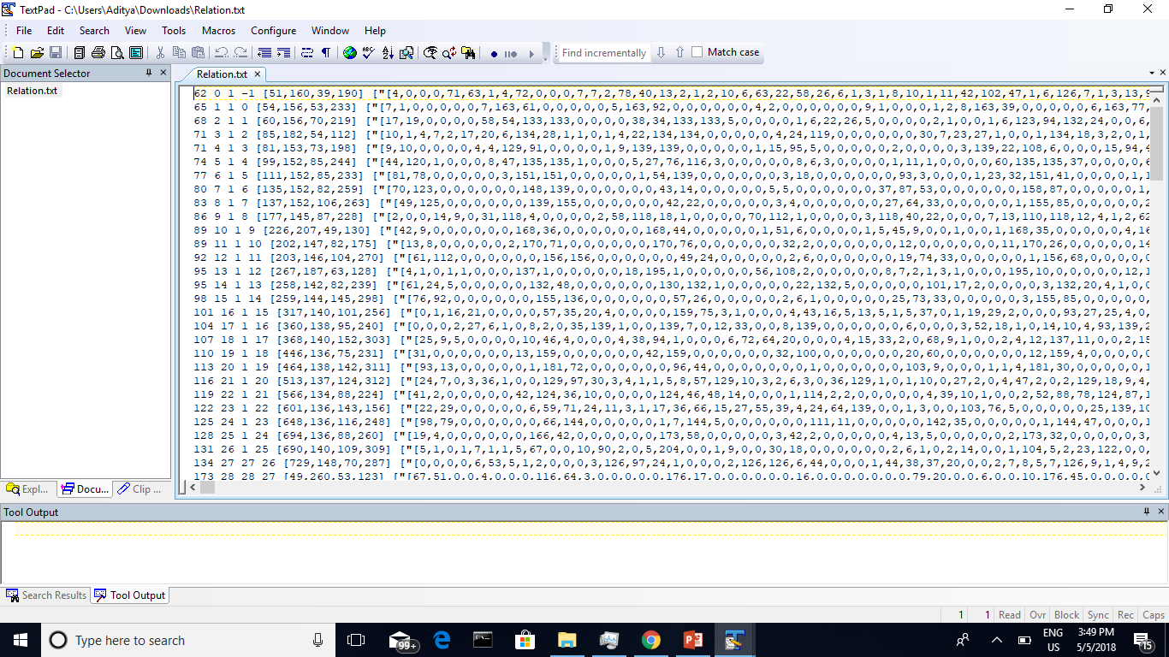
Tuple representation output

Slide 15
Conclusions
What you think you learned from this effort
We learnt important concepts about image processing and stream processing.
Do you think there is a paper from this project?
A potential paper can be written comparing the performance two systems developed in matlab and opencv against each other.
Feedback
This was a unique and challenging project.

Slide 16

Thank You !!!

